Slide 1


Slide 2


Becoming “Distinguished” with High Expectations
Inclusion of parents and students

Slide 3
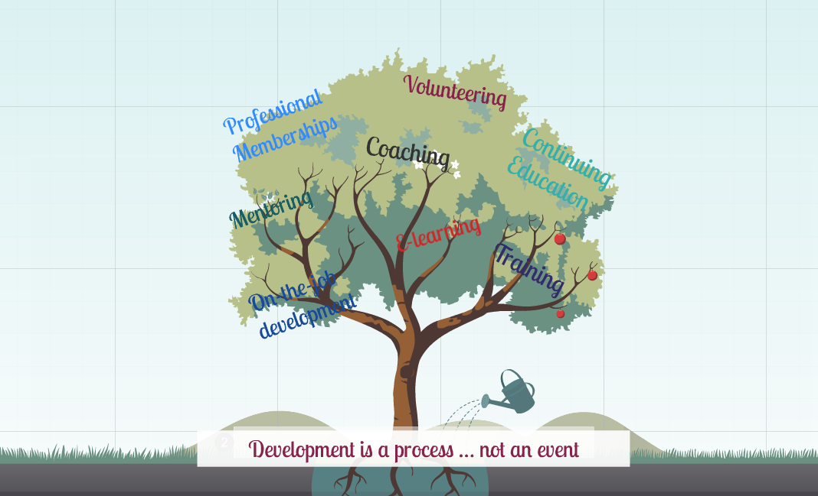

Slide 4

Very important members of your classroom community are
PARENTS

Slide 5

What any parent really wants in a child’s teacher
Enthusiasm, energy, a positive attitude
Competence, confidence
Personality, openness, respect, welcoming
Well-planned, multi-dimensional
Honesty
Understanding of total school experience
High expectations
Reasonable, worthy assignments tied to curriculum
Substantive feedback on assignments and tasks

Slide 6

First class (Class X)
Summary of Parents expectation
High Result
School | Strength | English | II Language | Maths. | Science | S Science
 | 192
 | 100
 | 49

Slide 7

SUMMARY OF PARENTS EXPECTATION
Love
Care
Good Teaching
Motivation
Security
Happiness
School

Slide 8


NEXT PTM
Are you prepared?

Slide 9
STUDENT ACHIEVEMENT
STRATEGY
Plan for next three months
Good Teaching
Behaviour Management
Teachers Engagement
Investing in Outcomes, Data, Practices, and Systems
Increasing District & State Competency and Capacity
Competency Based Assessment
Diversification Strategy
No one left behind
Strategy
Active involvement of community

Slide 10
Expectations of students
Student achievement at the end of the year is directly related to the degree to which the teacher establishes good control of the classroom procedures in the very first week of the school year.

Slide 11
Every students want growth
Proficient
Change over time
Not Proficient
Start of
School Year
End of
School Year
Notes:
A focus on student growth or progress looks like…
Takes into account student achievement within range or beyond that range
Compares student achievement to how they were predicted to achieve
Discerns between teacher impact and student ability
Accounts for student ability before they came to class
“Improvement or progression”

Slide 12
Every students have following questions
Am I in the right track?
Am I recognized?
Why teacher are not caring me?
How will I be graded?
Why teacher is giving importance to only those students?
Why teacher is not treating me as a human being?
Can I do this?

Slide 13
Understand students feeling......
Area | IX | X | XI
I am poor in studies
Teachers are not caring me
Discrimination
Not treating as human being
Survey conducted among …… students of class x students
Used indirect questions during direct conversation

Slide 14
Expectation from teachers
Whole hearted Support
Prepare yourself before entering to class
Divergent teaching
Punctual

