Slide 2
Relationship Management and Training & Development

Slide 3
Relationship in the School
School management
Students
Parents
Teachers

Slide 4
Relationship Management in ………..
Teachers
Principal
Infrastructure
Parents
Non Teaching Staff
Your School Name
Students
CBSE and Government
Customer Satisfaction strategy

Slide 5
Strategy Used to know more about customers
Feedback Register
PTM
Personal Communication
Sample Survey
Automatic Messaging and call System

Slide 6
Resources Provided for the relationship
Call and Messaging System
Website Access (
Email and Notification
Multi Purpose Hall for Meeting
Intercoms
Announcing System

Slide 7
Relationship Management Policy
Retain
Grow
Up

Slide 8
Enhancing the Parents Relation in the in ………………….

Slide 9
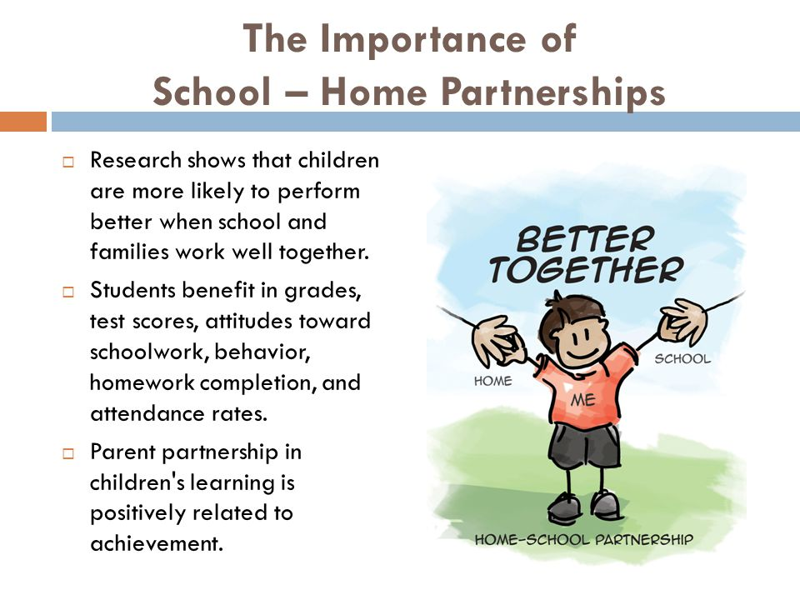

Slide 10
Partnering with Parents to Establish Community
“Schooling is first and foremost about relationships between and among students, teachers, and [parents], and… community building …[which improves] teaching and learning.”

Slide 11
Why we need relationship
Improve School Brand
Connect School to Community
Academic Development
Discipline

Slide 12
Our school is constantly communicating. In fact, even if you’re not actively sending out messages, you’re still saying something.
Every day our students give advertisement to school

Slide 13
We need to Build “bridges,” not walls between ourselves and parents.
What is our strategy
Class wise parents meeting
Individual discussion
Listening to the parents
Taking proper feedback
Information management System

Slide 14
Teachers Expectation

Slide 15
Five things TEACHERS wish PARENTS would do:
Be involved in the child’s education and accept parental responsibilities
Provide resources at home for reading and learning
Set a good example
Encourage children to do their best at school
Emphasize importance of academics

Slide 16
Now, what are THREE things you think PARENTS wish TEACHERS would do?

Slide 17
What PARENTS expect of TEACHERS
Keep their children safe
Treat their children fairly
Teach the material students need to succeed
Communicate early about problems

Slide 18
What Management Expect from Teachers

Slide 19
Have high expectations for self and students
Give reasonable, worthy assignments tied to curriculum
Provide substantive feedback on assignments and tasks
Make school a pleasant experience

Slide 20
Create a positive classroom community by . . .
Establishing routines and work habits in students first; content can come later
Teaching organizational skills
Learning students’ names
Planning your first day down to the minute
Standing as you speak
Using a firm but soft voice
Beginning many sentences with “We will…” and “You will…”

